Slide 1
The Biotechnology Ecosystem Innovation & Incentives
Jérôme Van Biervliet
Senior Business Development Manager

Slide 2

The draft Article 5(1)(b) of the TTBER excludes from automatic exemption any clause containing: “any direct or indirect obligation on a party not to challenge the validity of intellectual property rights which the other party holds in the European Union, including any right for a party to terminate the technology transfer agreement in the event that the other party challenges the validity of any of the intellectual property rights which a party to the agreement holds in the European Union.”

Slide 3








VIB is a life science research institute A Howard Hughes Model
>60 different nationalities

Slide 4


Scientific impact and source of innovation
Scimago ranking of Research Institutes based on top Quartile papers for Impact Factor
Source: Scimago, 2011; Nature Drug Discovery Kneller, 2010

Slide 5






























The Path towards value creation
Licensing Agreements
IPR
Expertise
New Ventures
Notes:
na record of invention moet je nu klikken (is een tweede slde). Vroeger kwam IPR automatisch na record of invention
Positie en grootte van groene blok ‘record of invention’ mag niet veranderd worden!!
Height: 3.5 cm
Width 5.21 cm
Horizontaal: 4.38
Verticaal: 8.45
Positie tekstblok ‘Record of Invention’:
Horizontaal 4.89 cm
Verticaal: 9.14 cm

Slide 6
Commercialisation in Biotechnology is a costly affair
VIB can reach early Lead stage with collaborators
Venture Capital – Backed Biotech development
Pharmaceutical company takes over
VC capital
VC capital
VC capital
License
License
Source: Paul et al., Nature Reviews, Drug Discovery 2010

Slide 7
Biotech industry is the creative engine for pharma,...
% Biotech within
Top 100 products

Slide 8
Licensing in pharmaceutical or agricultural biotechnology application is exclusive
Large Investments to be made
Scientific risks
Technical risks
Execution risks
Syndicate risks
Long term investments
High-risk due to attrition
Return on capital invested required by limited partners in VC

Slide 9
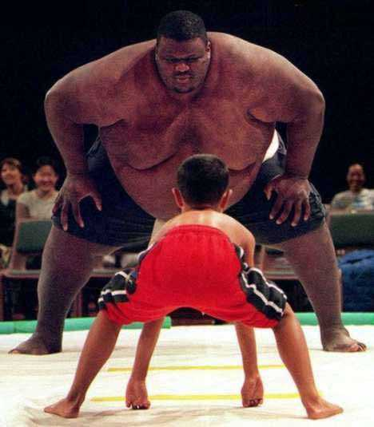

Bargaining position of licensor to licensee
VIB valorisation:
Reinvested into benefit for society
Governments look for economic development
Biotech companies:
Cash constraint
Publicly traded: impact of litigations on share price
No legal power

Slide 10
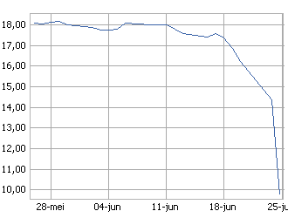
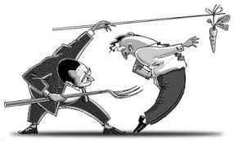
Mechanisms to ensure diligent development
Diligence requirements
Milestone schedules – Go-no-go’s
Challenge of validity of underlying patents
Commercially reasonable efforts
Who decides?
Audit? Benchmarks?
Reasonable efforts – Right to delay
Termination – grant back

