Slide 1
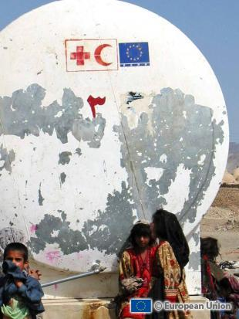
The relations between
the ICRC and the EU
Stéphane Kolanowski
ICRC Brussels
College of Europe, Natolin
22 February 2013

Slide 2
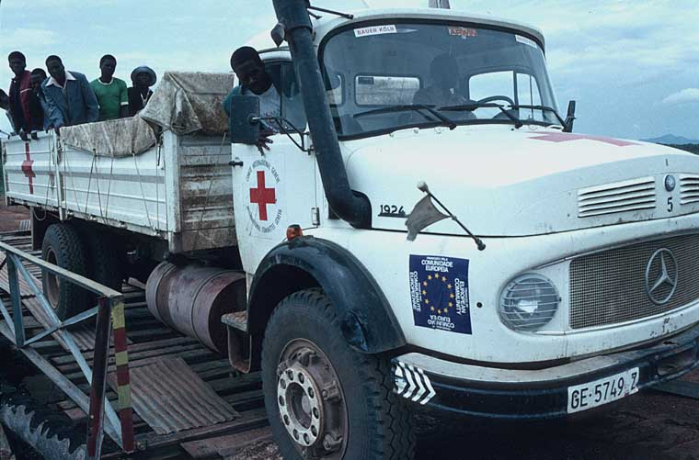
The ICRC and the EU
⇨ A relationship dating back to 1968
⇨ The European communities as a donor
➨ The EU has developped and has
become an international actor
☞ Change in our relationship
Focus on CFSP and CSDP

Slide 3
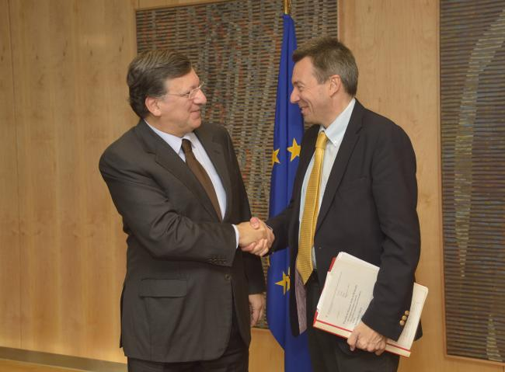
The ICRC and the EU today
Specific training and exchange of views (PR, GSCEU, EC, EEAS)
Participation in working groups: PSC, thematic, geographical
Bilateral (confidential) dialogue
Aim: awareness on humanitarian issues,
on IHL issues, on ICRC activities
A similar approach with other regional
or international organisations

Slide 4
The EU IHL Guidelines
A unique instrument
Not easy to implement
Relations with other Guidelines
Reporting as of 2012

Slide 5
The EU as a diplomatic actor
Development of IHL
Positioning on humanitarian issues (conferences…)
Influence on third States and non-state actors
Humanitarian mobilization
BUT: EU not always well perceived - limits

Slide 6
The EU as an economic actor
No ICRC involvment regarding:
sanctions
conditionality clause
ICRC interest but no direct involvment regarding:
ICC clause
Arms export

Slide 7
The EU as a development actor
Not really ICRC field of work but…
We are about to sign a contract based on Stability
Instrument (activities in Niger)
Some EU National Societies were financed to disseminate
IHL on the basis of the Human Rights and Democracy
Instrument

Slide 8
The EU as a legislative actor
No direct implication on IHL issues
Can have implication on operational issues (terrorism…)
Interest for the work of the Court

Slide 9
The EU as an operational actor
EU sometimes deployed in armed conflict situations
So far, has not been a party to an armed conflict, BUT…
Dialogue on doctrines and legal framework of operations
Dialogue on technical legal issues (ad hoc,
Bruges Colloquium, …)

Slide 10
What if the EU becomes party to an AC?
The example of NATO : Afghanistan and Libya
"Rappel du droit"
Confidence and understanding (what, how, why, confidentiality)
ICRC access to victims (notifications, detention, …)
Dialogue on the conduct of hostilities (field level, HQ level, reports,
demarches, …)
Dialogue on detention issues (capture, registration, notification to
the ICRC, treatment, release/transfer, residual responsibility/monitoring
post-transfer, …)
Issues of concern:
Many States, different obligations
The issue of State's and/or IO's responsibility

Slide 11
ICRC Delegation to the EU and NATO
7, rue Guimard
1040 Brussels
skolanowski@icrc.org
www.icrc.org

