Slide 1
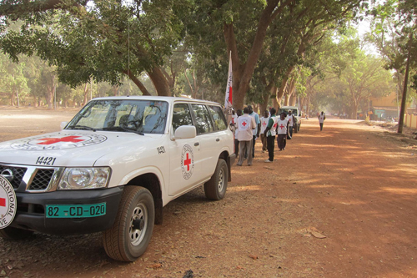
The ICRC’s humanitarian action in
today’s armed conflicts
Stéphane Kolanowski
ICRC Brussels
College of Europe, Natolin
22 February 2013

Slide 2
➨The International Committee of the Red Cross (ICRC):
Who we are?
What do we do?
➨Nowadays' armed conflicts: what challenges for the
humanitarians?
➨The ICRC and the EU

Slide 3
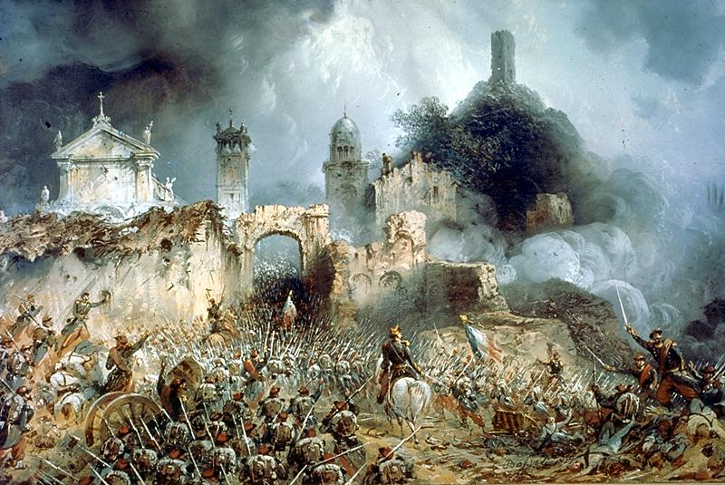
Origins of the Red Cross and of the ICRC
➢ 1859: Henri Dunant in Solferino
➢ 1863: Establishment of the « Comité de Genève »
➢ 1864: First Geneva Convention
➢ 1949: 4 Geneva Conventions
1977: 2 Additional Protocols
2005: 3rd Additional Protocol to the 1949 GC

Slide 4

The Movement
188 National Societies
194 States party to the
Geneva Conventions
ICRC
International Federation

Slide 5
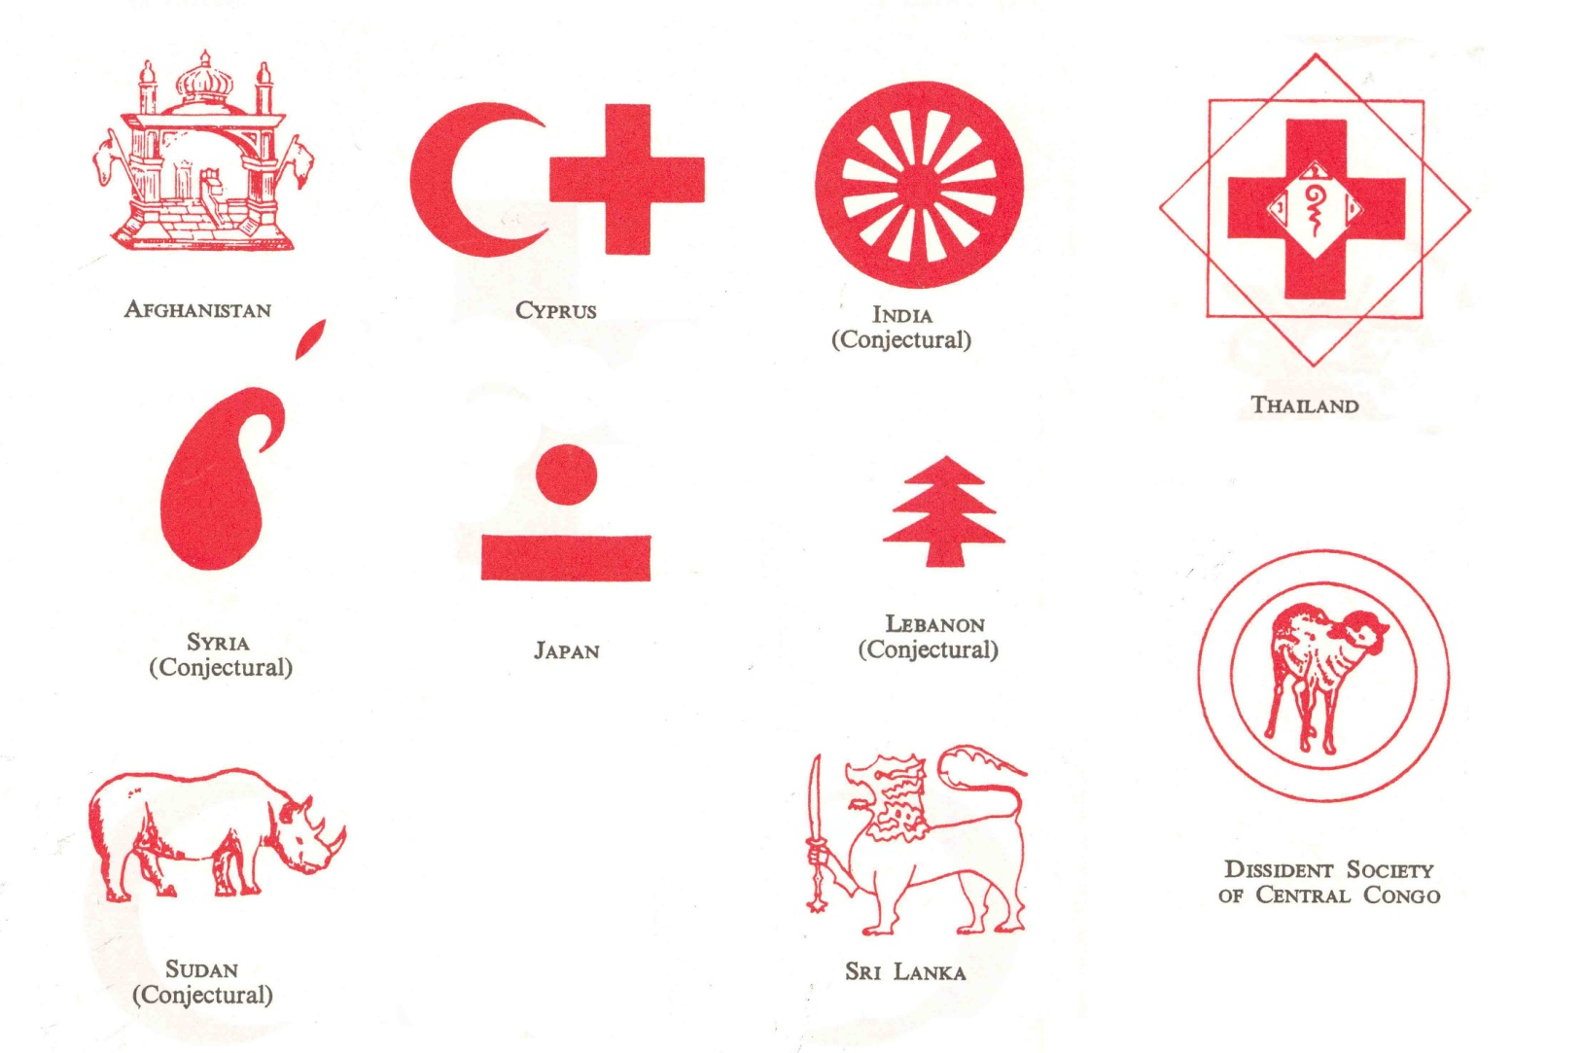
Non-recognized emblems

Slide 6

1864
1876…
1929
1929…
1980

Slide 7

2005: an additional emblem
for the Movement

Slide 8
Legal basis of our actions
➢ A mandate
4 Geneva Conventions
Statutes of the Movement
➢ A mission
The ICRC is an impartial, neutral and independent
organisation whose exclusively humanitarian mission
is to protect the lives and dignity of victims of war and
internal violence and to provide them with assistance.
It directs and co-ordinates international relief activities
conducted by the Movement in situations of conflict.
It also endeavours to prevent suffering by promoting
and strengthening humanitarian law and universal
humanitarian principles

Slide 9
ICRC Legal personality
 Private Swiss organisation (art 36 Swiss civil code)
 Mandate given by International Conventions
 International legal personality recognized by:
State practice
Seat agreements
Agreements with IOs
Decisions taken by national and international jurisdictions
➔ Neither an International Organisation (IO)
➔ Nor a NGO
➪ A sui generis organisation considered as an IO

Slide 10
The ICRC worldwide
In 2012: staff of + 12 000 with a permanent presence in 80 countries

Slide 11
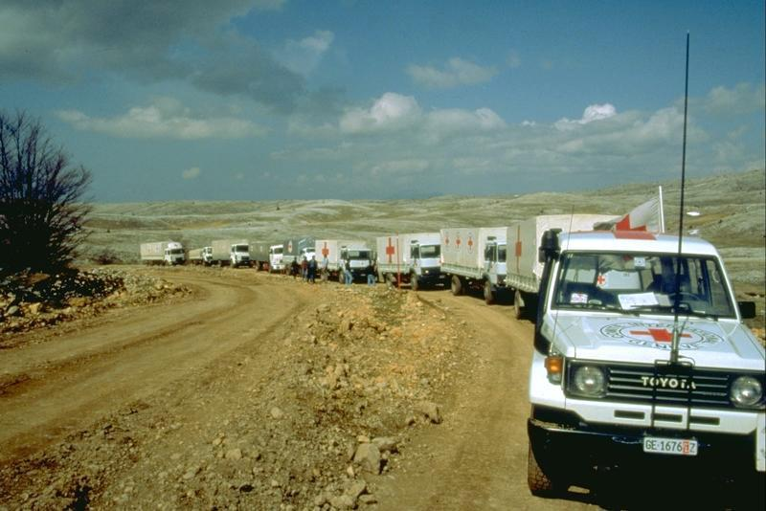
Financing the ICRC
Appeal 2013 : 979, 58 millions €
155,6 millions € HQ and 823,9 millions € field

Slide 12
20 major donors in 2012
Gvts / EC (cash/kind/services/assets)
Unaudited figures as of 05.02.2013

Slide 13
10 largest operations
Afghanistan
Somalia
Iraq
Niamey regional
The Democratic Republic of the Congo
Sudan
Israel and the Occupied Territories
Yemen
Syria
Colombia

Slide 14
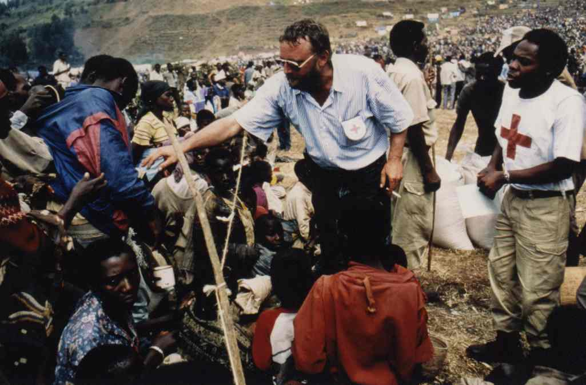
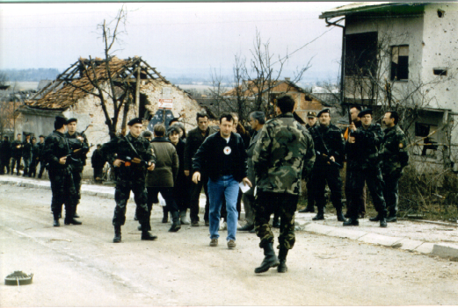
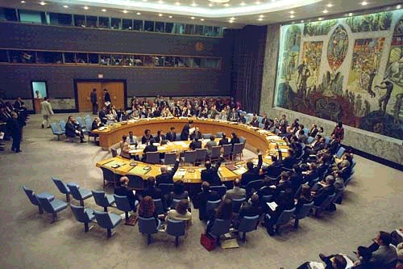
Principles and modus operandi
IMPARTIALITY
NEUTRALITY
INDEPENDENCE
CONFIDENTIALITY

Slide 15
Activities
Protection
 protection of civilians and detainees
 protection of family unity
 Assistance in favor of the victims
 economic security
 water and habitat
 medical/health care
 Preventive action
 dissemination of international humanitarian law

Slide 16
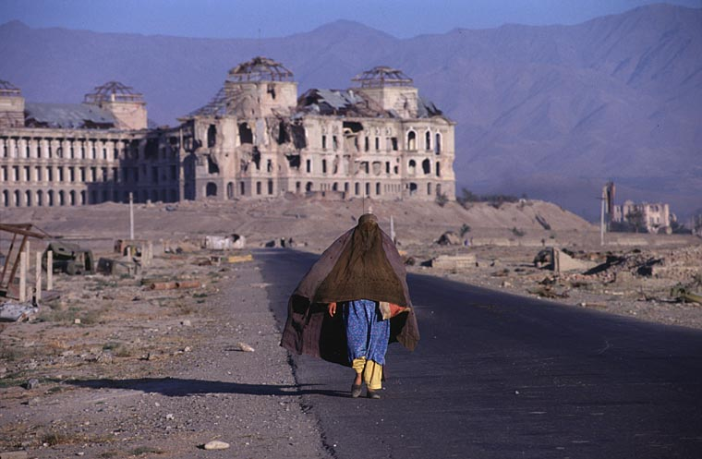
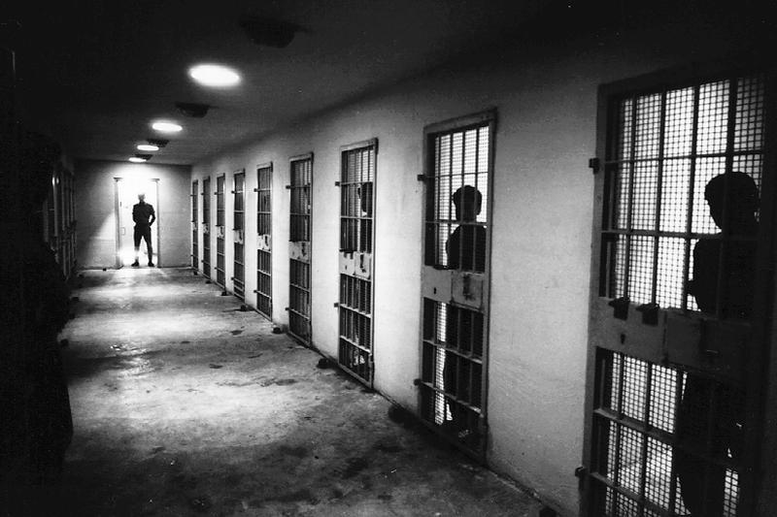
Protection of civilians
4th Geneva Convention
+ IDPs
+ Women and children
"Detention" activities
3rd Geneva Convention
Other detainees
Avoid disappearances and
mistreatment
- Family links
In 2012: +500 000 detainees visited
in + 2500 places of detention
in +70 countries

Slide 17
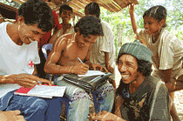
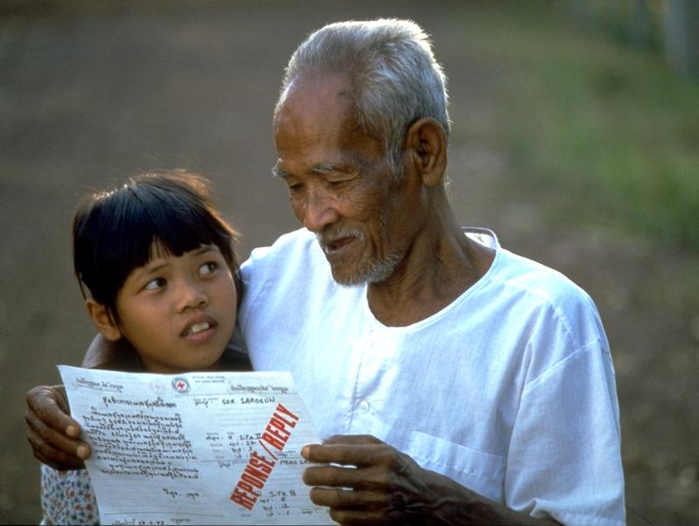
Restoring family links
➢ Central Tracing Agency (CTA)
➢ "Red Cross Messages" (RCM)

Slide 18
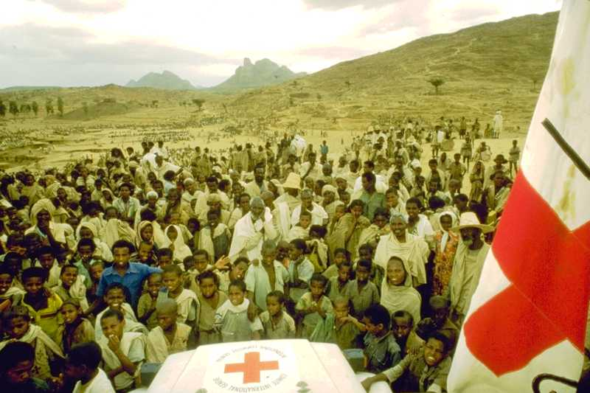
Assistance
Economic security:
➢ Survival means
➢ Direct economic aid
➢ Economic rehabilitation

Slide 19
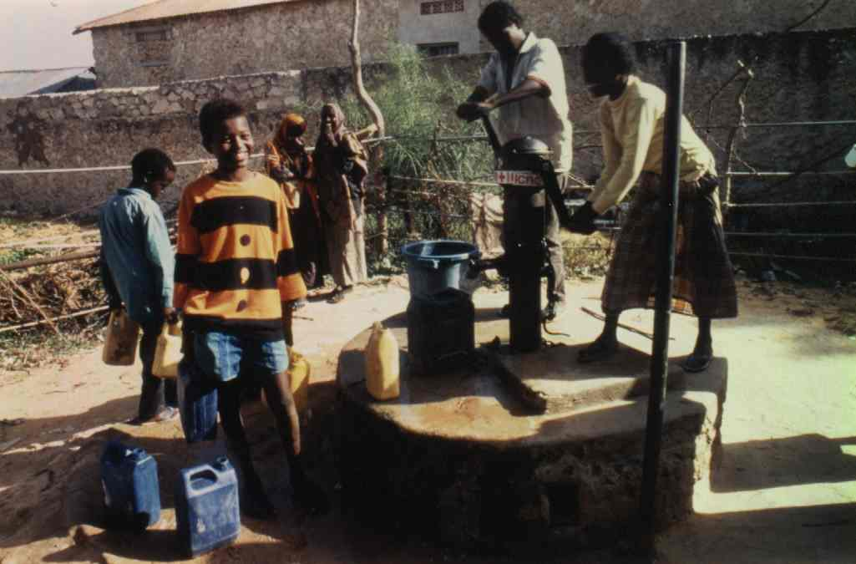
Water and habitat:
➢ Access to clean water
➢ Evacuation of waste water
➢ Decent shelter
* Rehabilitation of infrastructures
* Camps for displaced persons

Slide 20
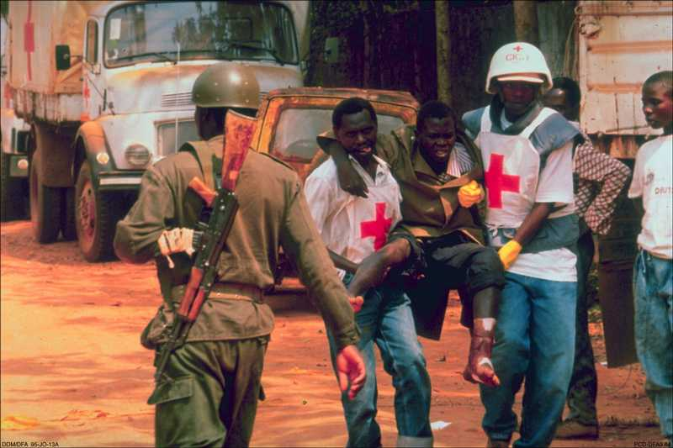
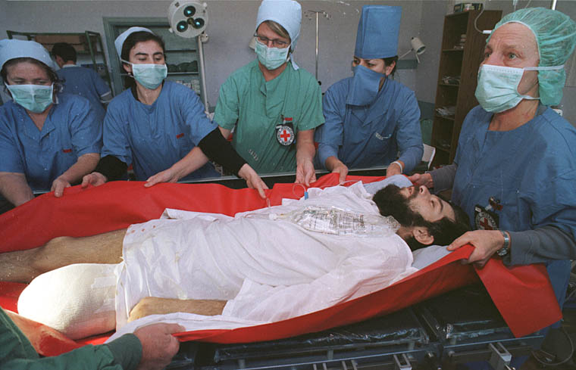
Medical/Health care
➢ Primary medical care
➢ First aid
➢ War surgery
➢ Health in places of detention
➢ Orthopedics and rehabilitation

Slide 21
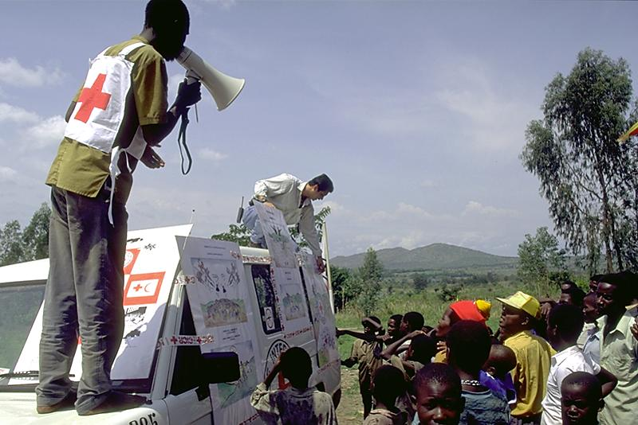
Preventive action
➢ Awareness
➢ Promotion of international humanitarian law (IHL)
➢ Integration of IHL in schools, university and military
cursus

Slide 22
What challenges for the humanitarians in
today's conflicts ?
* Access to the victims
* Security
* Respect for the emblem
* Nature of conflicts
* Multiplication of humanitarian actors - coordination
* Humanitarian and politico-military actions
* The need for a neutral and independant humanitarian action

Slide 23
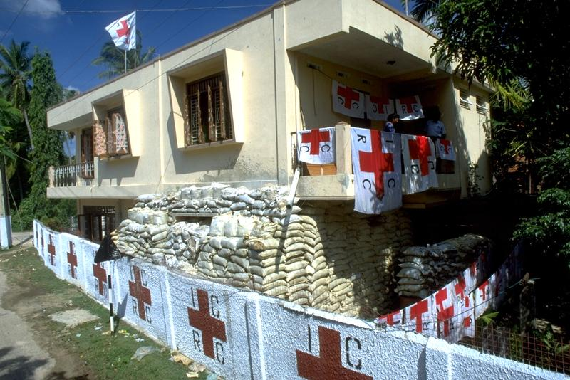
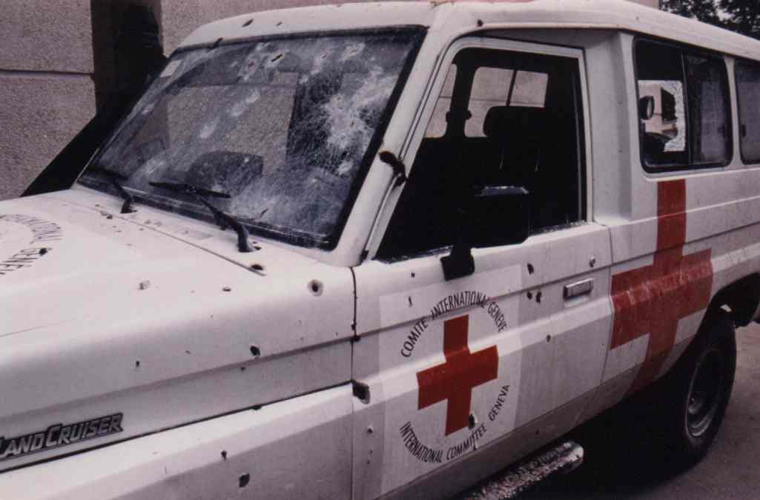
The emblem of the Red Cross
or the Red Crescent
* protection of humanitarians
* no armed escort
* respect is a requirement
for action
Security incident
* security unit
* permanent analysis in the field
and in Geneva
* decision of suspension or
withdrawal

Slide 24
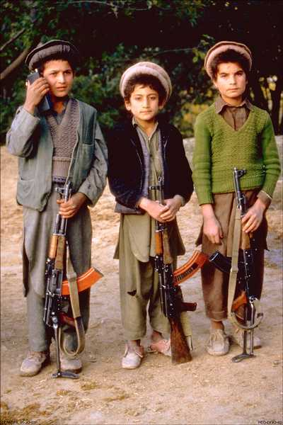
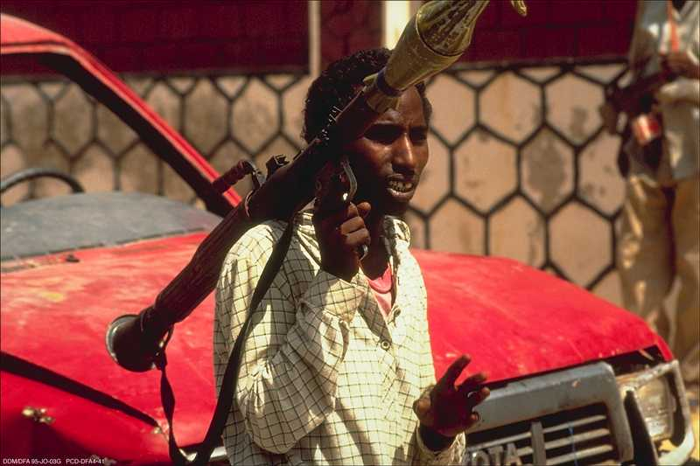
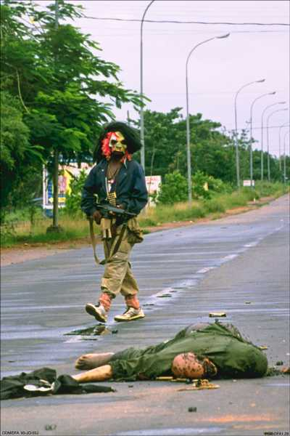
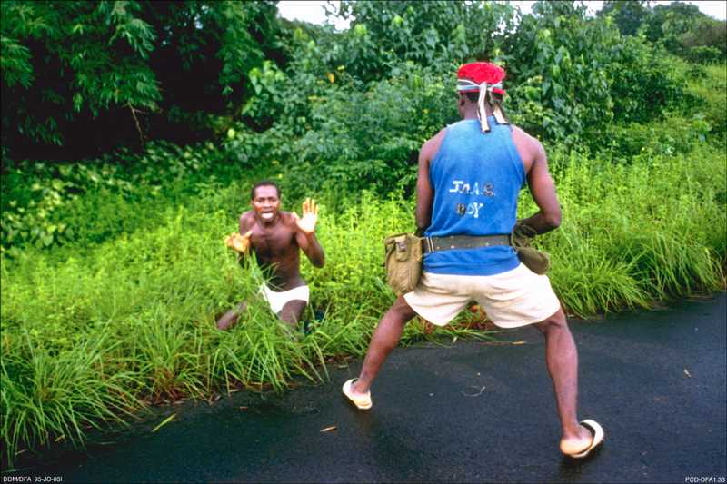
Un-identified arms carriers, un-clear chain of command
un-structured armed groups, radicalisation, banditry ….

Slide 25

ICRC & THE COMPREHENSIVE APPROACH'
Elements
Activities
DIPLOMATIC/POLITICAL
Administration
Governance
Rule of Law
End State
MILITARY/SECURITY
Stabilisation
STABLE
AND
FAIR
SOCIETY
Civilian Control
Training IHL/HR
Market Access
ECONOMIC
Free Trade
POLITICAL
OBJECTIVES
Education
Healthcare
HUMANITARIAN/SOCIAL
Basic Services
Victims of
Conflict

Slide 26
ICRC Delegation to the EU and NATO
7, rue Guimard
1040 Brussels
skolanowski@icrc.org
www.icrc.org

