Slide 1
Protected Persons
Prisoners of war and other detainees
in armed conflicts
Protection of wounded, sick and shipwrecked
Dr. Elżbieta Mikos-Skuza
Seminar „Introduction to International Humanitarian Law”
College of Europe, Natolin, 20th February 2013

Slide 2
Protected persons
GENERAL CONCEPT – BORN IN IAC
ENEMY NATIONALS
who do not (civilians) or no longer (combatants hors de combat - POW, wounded, sick and shipwrecked) take part in hostilities and therefore enjoy protection under international law
Art. 13 GC I and II, art. 4 GC III and IV

Slide 3
Definition of a POW
POW = combatant who founds himself / herself in the hands of the adverse party to a conflict because of a capture or a surrender
Captivity in war is “neither revenge, nor punishment, but solely protective custody, the only purpose of which is to prevent the prisoners of war from further participation in the war”.
(Statement of German Admiral Canaris in protest against the regulations concerning Russian POWs issued by the German army authorities, approved of as legally correct by the IMT )

Slide 4
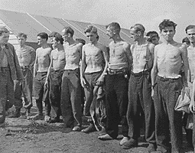
Treaties – prisoners of war
- 1899 HR
- 1907 HR
- 1929 II GC
- 1949 III GC
- 1977 I PA

Slide 5
What is the legal basis for detaining POWs?
Art. 21 GC III – Detaining Power may subject POWs to internment. It may impose on them the obligation of not leaving (…) the camp where they are interned …
This rule constitutes the lex specialis justifying deprivation of liberty which would otherwise, under HRL, constitute a violation of the right to personal liberty.

Slide 6
Who is a combatant and who is entitled to POW status?
Hague Regulations of 1907 (Arts. 1 and 2 Hague Regulations annexed to Hague Convention IV of 1907); POW Convention of 1929 (Art. 1 - extending to aerial and naval warfare)
Members of armies (incl. militia or volunteer groups)
Members of militia and volunteer corps fulfilling 4 conditions
  Commanded by a person responsible for his subordinates
  Have a fixed distinctive emblem recognizable at a distance
  Carry arms openly
  Conduct their operations in accordance with the laws and customs of war.
Levée en masse

Slide 7
Who is a combatant and who is entitled to POW status?
Art. 4 Geneva Convention III of 1949:
  Members of armed forces of a Party to the conflict as well as militias or volunteer corps forming part of such armed forces
  Members of other militias and members of other volunteer corps, including those of organized resistance movements, belonging to a Party to the conflict, PROVIDED that they fulfil the following conditions:
    Being commanded by a person responsible for his subordinates
    Having fixed distinctive sign recognizable at a distance
    Carrying arms openly
    Conducting operations in accordance with the laws and customs of war

Slide 8
Who is a combatant and who is entitled to POW status?
  Art. 4 Geneva Convention III of 1949:
  Members of regular armed forces who profess allegiance to a government or an authority not recognized by the Detaining Power (…)
  6. Inhabitants of a non-occupied territory, who on the approach of the enemy spontaneously take up arms to resist the invading forces, provided they carry arms openly and respect the laws and customs of war.

Slide 9
Who is a combatant and who is entitled to POW status?
Art. 43(1) Additional Protocol I of 1977
Combatant = member of armed forces
The armed forces of a Party to a conflict consist of all organized armed forces, groups and units
Which are under a command responsible to that Party for the conduct of its subordinates
Subject to an internal disciplinary system to enforce compliance with the rules of IHL

Slide 10
AP I – POW status
Art. 44(1) – Any combatant who falls into the hands of an adverse Party is POW
Art. 44(2) – violations of IHL do not deprive a combatant of POW status, EXCEPT
Art. 44(3) – combatants are obliged to distinguish themselves from the civilian population during and prior to each military engagement. In situations where this is not possible, combatants must carry arms openly during each military engagement and during deployment preceding the launching of an attack
Art. 44(4) – Combatants who fail to so distinguish themselves forfeit their POW status

Slide 11
COMBATANTS WHO DON’T ENJOY THE STATUS OF POW:
Spies (Art. 29 – 31 HR 1907, Art. 46 PA I 1977) – persons acting clandestinely or on false pretences / captured before rejoining the army to which they belong
Deserters (national laws)
Probem of mercenaries – „not have the right to be a combatant or a prisoner of war”

Slide 12
Non-combatants who enjoy the status of POW
  4. Persons who accompany the armed forces without actually being members thereof (e.g., war correspondents, supply contractors – provided they have received authorization …)
  5. Members of crews of the merchant marine ships and the crews of civil aircraft
  Art. 4 Geneva Convention III of 1949:

Slide 13
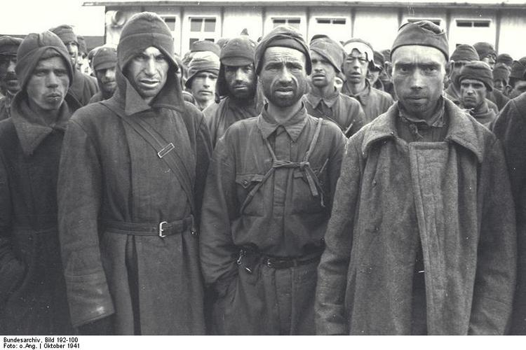
Treatment of POWs
Russian POWs in the German-controlled Mauthausen Camp, 1941

Slide 14
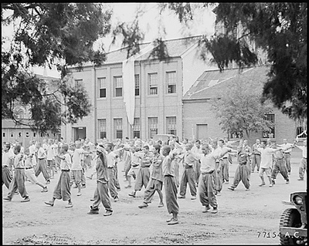
Treatment of POWs
North Korean POWs in Vietnam in 1973

Slide 15
Treatment of Prisoners of War
Captured combatants must be granted POW status upon capture by the enemy; obligation to accept surrender followed by internment or release (Art. 4 GC III; Art. 44 AP I)
Application of GC III from the moment a combatant falls into the power of the enemy (Art. 5 GC III)
Non-renunciation of rights secured to POWs by GC III (Art. 7 GC III)
POWs are in the hands of the enemy state and not of individual soldiers; detaining state is responsible for their treatment (Art. 12 GC III)
General provisions on humane and honourable treatment (Arts. 13, 14 GC III), including protection against public curiosity
Prohibition of discrimination on grounds of race, nationality, religious belief or political opinion (Art. 16)
Reprisals against POWs are prohibited (Art. 13(3)

Slide 16
What rules apply to interrogations of POWs?
Art. 17 GC III
  Obliges POWs only to give surname, first names and rank, date of birth, and army, regimental, personal or serial number.
  Prohibits:
    Physical and mental torture
    Any other form of coercion to secure information of any kind
    Threats, insults, unpleasant or disadvantaged treatment of any kind

Slide 17
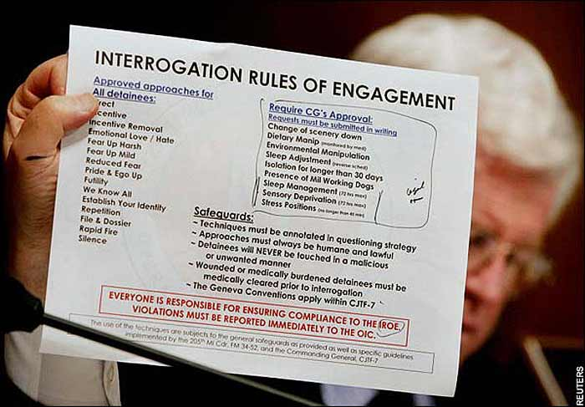
What rules apply to interrogations of POWs?

Slide 18
Registration and communication rights
Immediately upon capture, POW may write a card to his family and to the Central Prisoner of War Agency, informing them of his state of health and the address where they are being held (Art. 70)
They may continue to write and receive letters and cards throughout their internment (Art. 71)
All parties to the conflict are obliged to set up an official Information Bureau for POWs, which keeps a record of all POWs in its power (Art. 122)
The Central Prisoners of War Agency is set up in a neutral country, which facilitates the transmission of information to the country of origin or the power on which the POW depends (Art. 123)

Slide 19
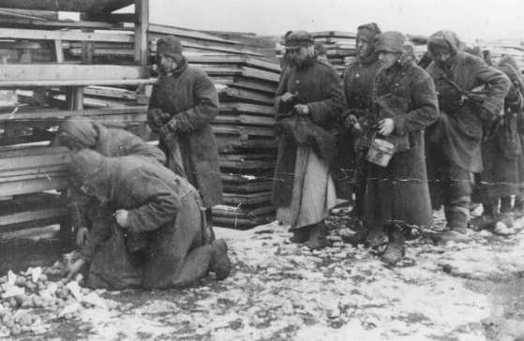
Specific rules on treatment of POWs
Adequate shelter (Art. 25)
Food and water (Art. 26)
Medicine (Arts. 30-32)
Clothing (Art. 27)
Hygiene (Art. 29)
Physical and religious activities (Arts. 34-38)
Strict regulations on labour (Arts. 49–57)
Russian POWs lining up for rations during forced labor at the narrow-gauge railroad station. Mlawa, Poland occupied by Nazists, about 1943.

Slide 20
Rules on judicial proceedings (GC III)
POW status ≠ immunity fo violations of IHL
Art. 82: POWs are subject to the laws and regulations in force in the armed forces of the detaining power
Art. 86: Ne bis in idem protection
Art. 99: protection against ex post facto laws and forced confessions
Art. 103: Investigations as rapid as possible
POWs not to be confined while awaiting trial unless a member of the armed forces DP would be so confined or if in interests of national security and in no circumstances may this exceed 3 months.
Art.99(3), 105: Right to legal assistance, call witnesses and an interpreter
Art. 105(5): Only basis for in camera trial is in the interests of State security
Art. 106: Right of appeal

Slide 21
Rules on judicial proceedings
Wilfully depriving a POW of the rights of a fair and regular trial is a grave breach of GC III (Art. 130)
Even if sentenced, POWs retain their POW status (Art. 85)
POWs may not be sentenced to penalties except those provided for in respect of members of the armed forces of the DP (Arts. 87 and 102)
Death penalty may be given, but the court must consider the fact that the accused, not being a national of the DP, is not bound by any duty of allegiance and that he is in its power as a the result of circumstances independent of his own will (Arts. 87 and 100)
Sentence must be served in the same establishments and in the same conditions as is the case of members of the armed forces of the DP, and must in all cases conform to the requirements of health and humanity (Art. 108)

Slide 22
Access rights of the ICRC
The ICRC, as well as representatives or delegates of the Protecting Powers have permission to go to all places where POWs may be, and have access to all premises occupied by POWs.
Visits are virtually unrestricted in terms or frequency and duration, except – on a temporary basis – for reasons of imperative military necessity (Art. 126)
ICRC may talk to prisoners individually and without witnesses

Slide 23
Right to escape?
Art. 91, 92 GC III
The escape of a POW is successful when:
- he has joined (his…) armed forces…
- he has left the territory under the control of the detaining state..
If recaptured – not liable to any punishment in respect of their previous escape
Unsuccessful escape (POW recaptured before having made good his escape) – POW liable only to a disciplinary punishment , even if it is a repeated offence and may be subjected to special surveillance (not entailing the suppression of any of the safeguards granted by GC III)
Art. 42
The use of weapons against POWs, especially against those who are escaping or attempting to escape, constitutes an extreme measure, always preceded by warnings appropriate to the circumstances

Slide 24

End of captivity: repatriation
US soldiers being briefed prior to their release from a prisoner of war camp in Vietnam in 1973

Slide 25
End of POW status and detention
‘Prisoners of war shall be released and repatriated without delay after the cessation of active hostilities’ (Art. 118 GC III)
Exceptions for:
severly wounded or through agreements
POWs detained under the penal sanction
Art. 85(4)(b) of AP I makes the unjustifiable delay in the repatriation of POWs a war crime.
What happens if a POW doesn’t want to be repatriated?

Slide 26
Grave breaches/war crimes in relation to POWs
Art. 130 GC III:
  wilful killing,
  torture or inhuman treatment, including biological experiments,
  wilfully causing great suffering or serious injury to body or health,
  compelling a prisoner of war to serve in the forces of the hostile Power,
  wilfully depriving a prisoner of war of the rights of fair and regular trial prescribed in this Convention.
Art. 85(4)(b) AP I:
  unjustifiable delay in the repatriation of POWs
Art. 8(2)(a) Rome Statute of the ICC:
  (v) Compelling a prisoner of war or other protected person to serve in the forces of a hostile Power
  (vi) Wilfully depriving a prisoner of war or other protected person of the rights of fair and regular trial.

Slide 27


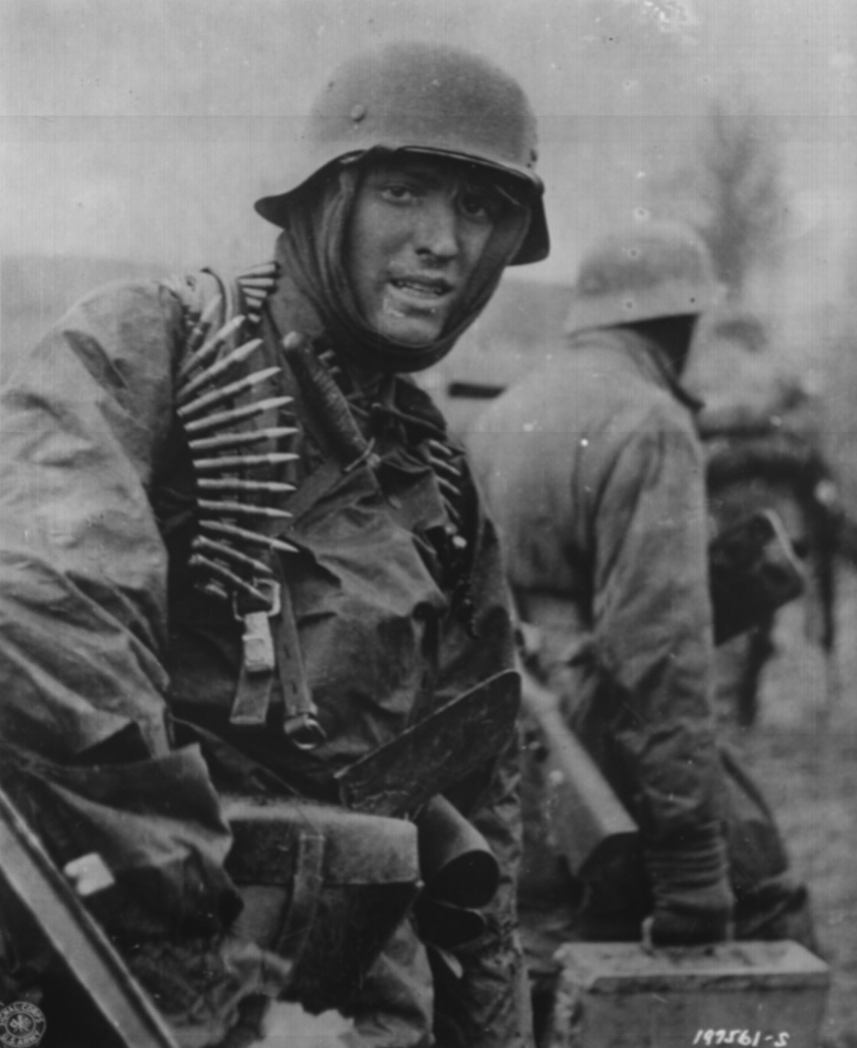
What should a combatant look like?
US Civil War
World War I
World War II

Slide 28
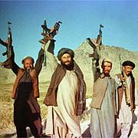
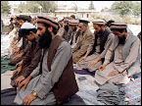
What should a combatant look like?
Taliban forces celebrating after
retaking land from Northern Alliance
Civilian Afghans praying

Slide 29
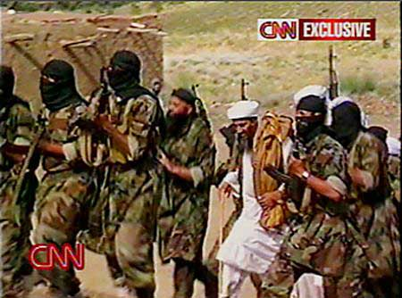
What should a combatant look like?
Osama Bin Laden with Al Qaida bodyguards

Slide 30
What if status is doubtful?
Art. 5 GC III
“Should any doubt arise as to whether persons, having committed a belligerent act and having fallen into the hands of the enemy, belong to any of the categories enumerated in Article 4, such persons shall enjoy the protection of the present Convention until such time as their status has been determined by a competent tribunal.”

Slide 31
What if status is doubtful?
Art. 45(1) AP I
“A person who takes part in hostilities and falls into the power of an adverse Party shall be presumed to be a prisoner of war, and therefore shall be protected by the Third Convention, if he claims the status of prisoner of war, or if the Party on which he depends claims such status on his behalf …. Should any doubt arise as to whether any such person is entitled to the status of prisoner of war, he shall continue to have such status and , therefore, to be protected by the Third Convention and this Protocol until such time as his status has been determined by a competent tribunal”

Slide 32
What if status is doubtful?
Art. 45 (2) AP I
“If a person who has fallen into the power of an adverse Party is not held as a prisoner of war and is to be tried by that Party for an offence arising out of the hostilities, he shall have the right to assert his entitlement to prisoner-of-war status before a judicial tribunal and to have that question adjudicated. Wherever possible under the applicable procedure, this adjudication shall occur before the trial for the offence.”

Slide 33
What if status is doubtful?
Art. 45 (3)
“Any person who has taken part in hostilities, who is not entitled to prisoner-of-war status and who does not benefit from more favourable treatment in accordance with the Fourth Convention shall have the right at all times to the protection of Article 75 of this Protocol.”

Slide 34
What if status is doubtful?
Special role of Art. 75 AP I
Minimum standards of protections to every person in state’s hands, including own civilians and those who have taken part in hostilities, but are not entitled to POW status
Art. 75 AP I (Fundamental guarantees)
  Humane treatment, without adverse discrimination
  Prohibits:
    Violence to life and health (murder, torture, etc.)
    Outrages upon personal dignity (incl. indecent assault)
    Taking of hostages
    Collective punishments
    Threats to commit these acts
  Any person arrested, detained or interned for actions related to the armed conflict shall be informed promptly of the reasons why these measures have been taken.
  No sentence may be passed and no penalty may be executed prior to a conviction by an impartial and regularly constituted court (lists the ‘principles of regular judicial procedure’)

Slide 35
Martens Clause
Preamble to 1899 Hague Convention II, Art. 63(4) GC I, Art. 1(2) AP I and preamble AP II
‘In cases not covered by the law in force, the human person remains under the protection of the principles of humanity and the dictates of the public conscience.’

Slide 36
Contemporary practice
The Guantanamo detainees
2002 Inter-American Commission of Human Rights: requested US to take the “urgent measures necessary to have the legal status of the detainees at Guantanamo Bay determined by a competent authority”
Hamdi v. Rumsfeld, United States, Judgment of the Supreme Court of the US, 28 June 2004, 542 U.S. 507 (2004): An American detainee had the right to have the lawfulness of his detention determined
Rasul v. Bush, 542 U.S. 466 (2004): extended this right to all foreign detainees
7 July 2004: Order creating the Combatant Status Review Tribunal to review the status of each detainee at Guantanamo as an “enemy combatant”
Detainee Treatment Act (2005): strips US courts of jurisdiction over habeas corpus petitions and vests exclusive review of final decisions of CSRTs and military commissions in the DC Circuit Court.

Slide 37
Contemporary practice
The Guantanamo detainees
Hamdan v. Rumsfeld et al., United States, Judgment of the Supreme Court of the United States of 29 June 2006, 126 S.Ct. 2749 (2006): DTA did not preclude federal jurisdiction of pending habeas actions.
Military Commissions Act (2006): Eliminated judicial review for any claims challenging any aspect of detention or treatment of all non-citizen detainees determined to be “enemy combatants” and ratified CSRTs as substitute for habeas corpus
Boumediene et al. v. Bush et al., United States, Supreme Court, Judgment of 12 June 2008: Guantanamo detainees retained the constitutional privilege of habeas corpus. Found the DTA’s procedures for reviewing detainees’ status were not adequate and effective substitute for habeas corpus.

Slide 38
Non-international armed conflicts:
What is the status of captured fighters?
Absence of POW status
General protections apply to captured persons no longer taking an active part in hostilities
  Common Article 3 of the GCs (e.g., right to life, respect of human dignity, judicial guarantees)
  Arts. 4, 5 and 6 of Additional Protocol II of 1977
  Human rights law remains applicable

Slide 39
Wounded, sick and shipwrecked
Wounded soldiers – protection by a multilateral treaty since 1864; shipwrecked – since 1899; sick – since 1906 ; at present – GC I & II 1949 and PA I & II 1977
Includes the protection of:
- medical and religious personnel (same status),
- medical units, e.g. hospitals, blood transfusion centers, medical depots,
- medical transports – vehicles, ships, aircrafts

Slide 40
Wounded, sick and shipwrecked
Until 1949 – only military; 1949 –civilian covered, different scope of protection; 1977 – almost same status of military and civilian
1977 - broad definitions, e.g. “wounded and sick” cover infirm, expectant mothers, maternity cases, new-born babies, who refrain from any act of hostility
Wounded and sick combatants who fall into enemy hands shall be POW (Art.14 GC I)

Slide 41
Definition of wounded and sick
W&S means persons, whether military or civilian, who, because of trauma, disease or other physical or mental disorder or disability, are in need of medical assistance or care and who refrain from any act of hostility. These terms also cover maternity cases, new-born babies and other persons (...), such as the infirm or expentant mothers, and who refrain from any act of hostility

Slide 42
Definition of shipwrecked
Shipwrecked means persons, whether military or civilian, who are in peril at sea or in other waters as a result of misfortune affecting them or the vessel or aircraft carrying them and who refrain from any act of hostility.

Slide 43

Wounded, sick and shipwrecked
*Protection and care, priority in accordance with medical reasons
* Loss of protection if commit (or are used to commit) acts harmful to the enemy
*Distinctive sign of medical
services in times of a.c.

